Slide 1


Project 4: Option Pricing

Slide 2
What is an option?
An option provides the holder with the right to buy or sell a specified quantity of an underlying asset at a fixed price (called a strike price or an exercise price) at or before the expiration date of the option.
Since it is a right and not an obligation, the holder can choose not to exercise the right and allow the option to expire.
There are two types of options - call options (right to buy) and put options (right to sell).

Slide 3
Option Pricing Models
The amount that an investor must pay for an option contract. This price is based upon factors such as the underlying security as well as the left until the options expiration date(T).
The two popular models are:
1. The Binomial Model
2. Black - Scholes Model

Slide 4
The Binomial Model
The model assumes,
The price of asset can only go up or go down in fixed amounts in discrete time.
There is no arbitrage between the option and the replicating portfolio composed of underlying asset and risk-less asset.

Slide 5
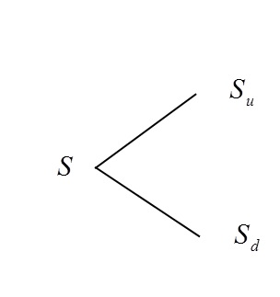
The Binomial Model Parameters
Current stock price = S
d <R <u (no risk free arbitrage possible)
Time period for T
r is risk free interest rate
K is the Strike price or exercise price
σ as volatility

Slide 6
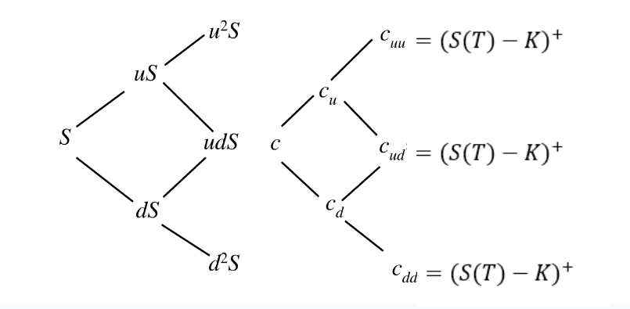
Two period Binomial model
Stock Price Diagram
Payoff Diagram

Slide 7

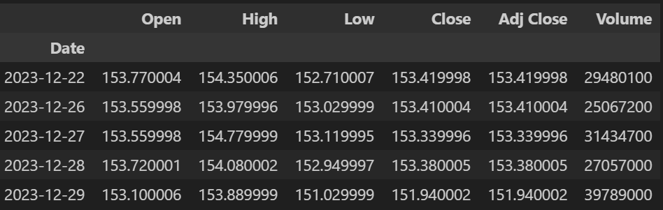
Stock we chose: Amazon(AMZN)
Historical Data

Slide 8
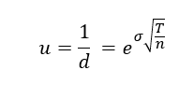
Parameters
Stock price S(0) = 173.85
10 Year Treasury Rate (r) : 4.62%
Strike Price (K) = 170
Up and Down factor

Slide 9
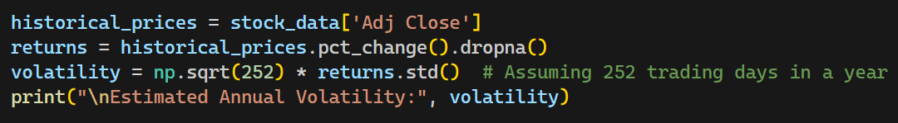
Annual volatility.
Estimated Annual Volatility (σ): 33.026%

Slide 10



Probability
Call Option Price
Put Option Price

Slide 11
Black Scholes Model :
The Black-Scholes formula calculates the theoretical prices of European call and put options based on the specified inputs.
The model assumes,
Constant Risk-Free Rate
Constant Volatility
Options can only be exercised at expiration, unlike American options that can be exercised at any time before expiration
Underlying asset's price follows a log-normal distribution

Slide 12
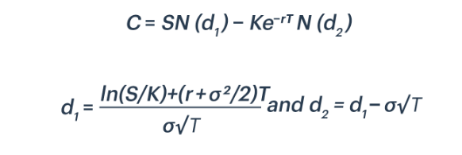
Black-Scholes Model: Option Pricing Formula
where
S = Underlying Asset Price
K = Strike Price
T = Time to Expiration
r = Risk-Free Rate
σ = Volatility of the Underlying Asset

Slide 13
Why Black scholes model is better than binomial model?
Continuous Model: The Black-Scholes model uses continuous time, which is more aligned with the real-world trading environment. The binomial model, on the other hand, uses discrete time steps.
Arbitrage-Free: Both models can be arbitrage-free but achieving this for binomial model can be more complex.
Simplicity: The Black-Scholes model has a closed-form solution, making it easier and faster to calculate option prices whereas the binomial model requires iterative calculations at each time step.
Flexibility: The Black-Scholes model can be extended to price a wide range of derivative securities, including options on dividend-paying stocks, currencies, and futures contracts. While the binomial model is versatile, it may require more adjustments and modifications to accommodate certain market features.

Slide 14
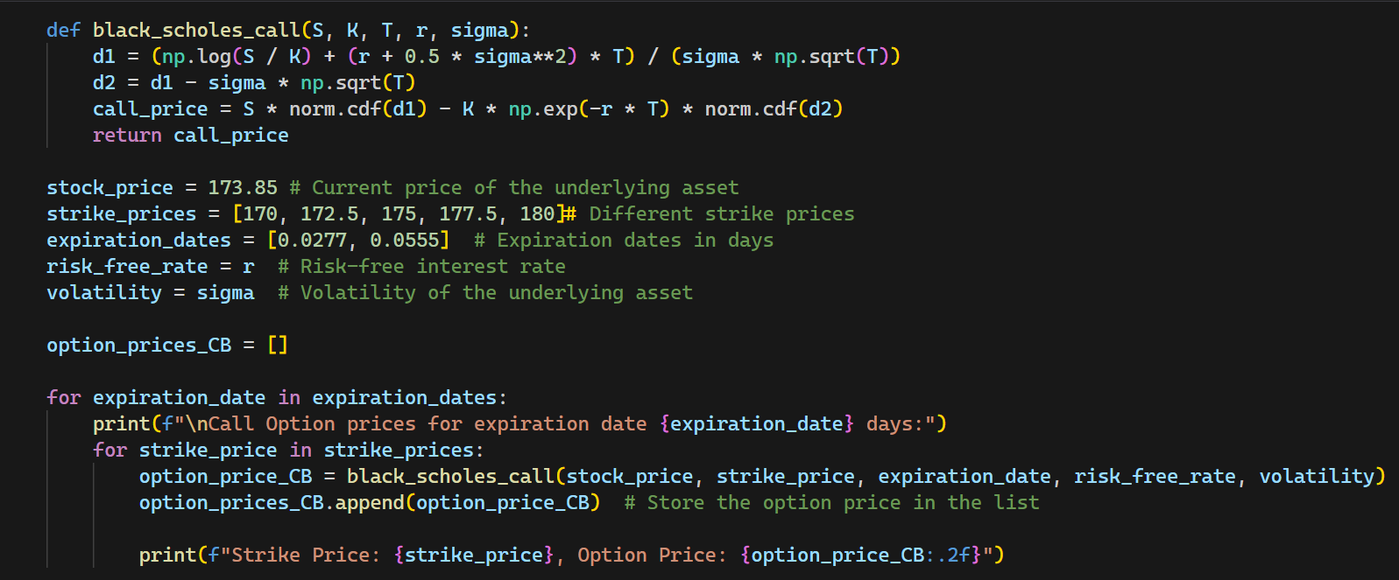

Slide 15
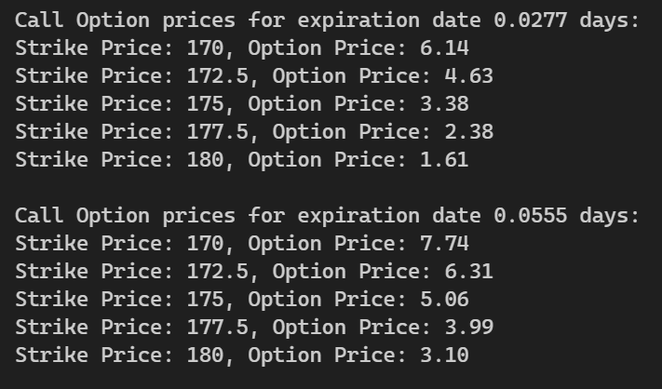

Slide 16
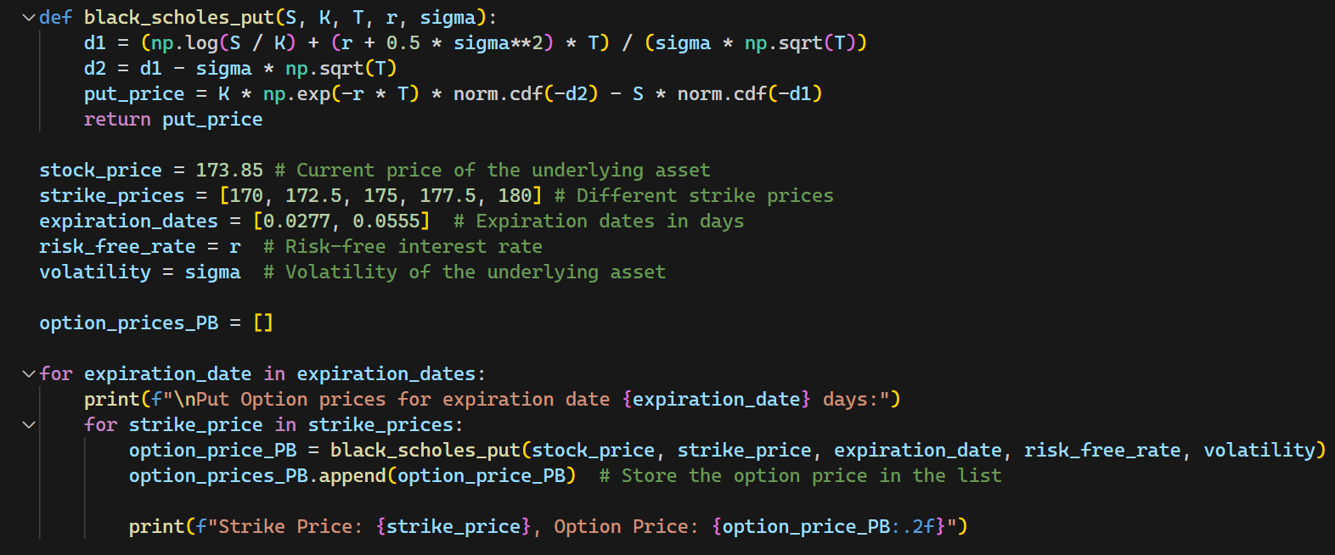

Slide 17
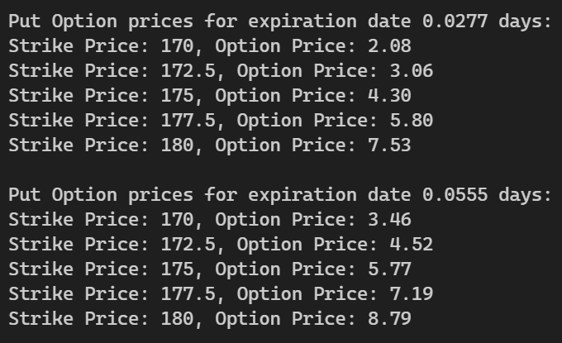

Slide 18
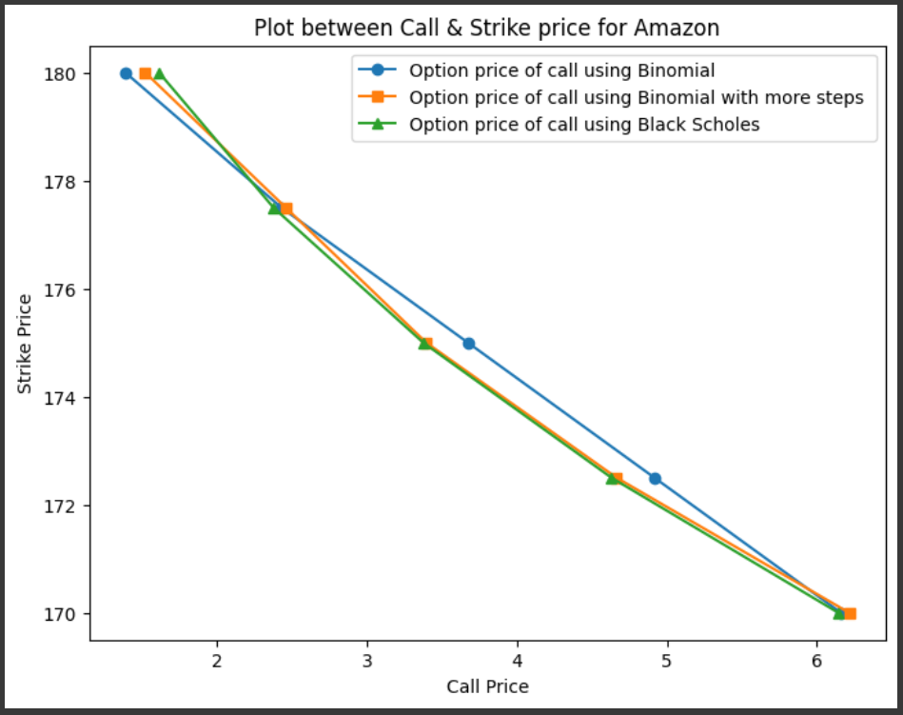

Slide 19
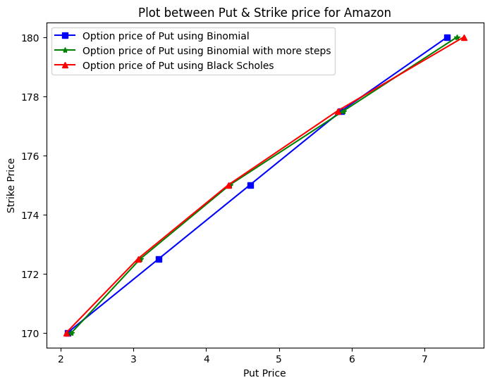

Slide 20
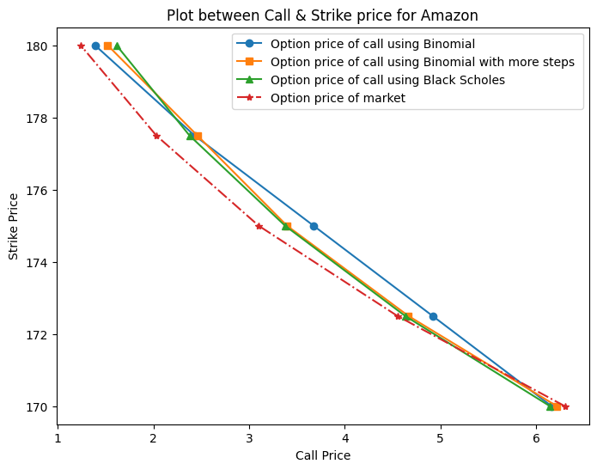
Comparison with market

Slide 21
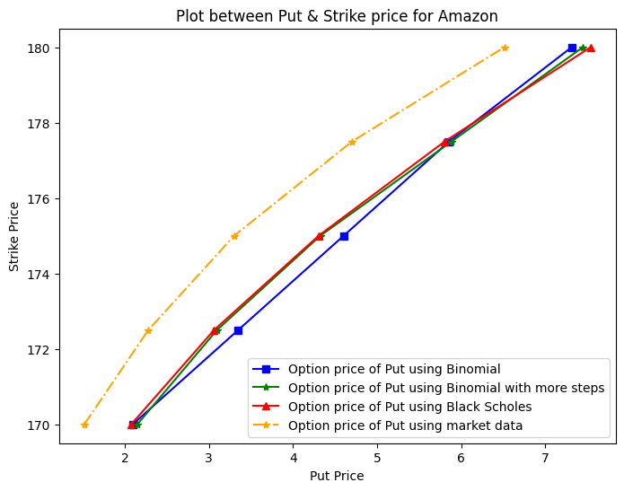
Comparison with market

Slide 22
Delta Neutral Portfolio
A delta-neutral portfolio is a strategy used by options traders to hedge against directional risk in their positions.
Delta measures the sensitivity of the option’s price to changes in the price of the underlying asset.
A delta neutral portfolio aims to have a total delta of zero.
If a trader holds a long position (owns) in call options, which have a positive delta, they may sell (short) shares of the underlying stock to offset the positive delta.
Conversely, if a trader holds a short position (sold) in call options, they may buy shares of the underlying stock to offset the negative delta.

Slide 23
Implied volatility
Implied volatility(IV) is derived from option prices, indicating the market's expectation of future volatility for a financial instrument. It reflects traders' perceptions of potential price movements in the underlying asset. Higher IV suggests greater anticipated price swings, influencing option prices. IV helps forecast market volatility, is crucial in options pricing models, and can vary across different options, providing insights into market sentiment and risk.

Slide 24
Applications of Black Scholes Model :
Option Pricing: Provides a theoretical framework for pricing European options.
Hedging: Helps investors and institutions hedge against price fluctuations in the underlying asset.
Risk Management
Limitations:
Assumption Sensitivity: The model's results can be sensitive to changes in its assumptions.
Market Dynamics: May not accurately capture real-world market dynamics, especially during extreme market conditions.
Other Models: Mention models like the Binomial Model that can address some limitations of the Black-Scholes model.

Slide 25
THANK YOU !!!

